Slide 1

New Restaurant Recommendations near Edison, NJ (USA) Anuj Sud Jan 1st, 2021

Slide 2
Providing recommendations to start new restaurant business around Edison, NJ
Edison, New Jersey is a densely populated suburbs in NJ and is well connected with NY for work commutation and has highly rated school system
Edison, NJ has a diverse group of communities with over ~100K in population as of 2019
Some of the neighboring cities like Metuchen, Plainfield, New Brunswick, Piscataway add on the neighborhood
Problem statement: Analyze existing businesses that provide restaurant services and derive recommendations on type of food category and possible location in this neighborhood that will make it a success based on past data and behaviors

Slide 3
Data Acquisition and Cleansing
Foursquare's Explore API only returned with 100 businesses around Edison, NJ coordinates with a 3 mile radius.
In order to enhance the data, I researched and found out that Yelp Fusion provides additional free APIs such as Business Search to obtain food/restaurant category business data.
https://www.yelp.com/developers/documentation/v3/business_search
Two key forms of data cleansing was required:
Converting price to numerical format. Yelp's API returned pricing as $, $$, $$$ format which was translated to 1,2,3.
Restaurant category had to be derived for clustering and grouping, and was converted to numerical format (using Factorize function)

Slide 4
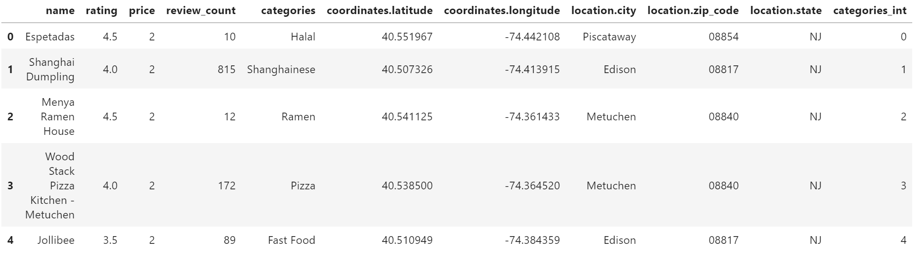
Business data after converting and cleansing

Slide 5
Exploratory Data Analysis
Using Pearson correlation, it's found that "Rating" and "Price" attributes are statistically significant while their liner regression is weak.
Similarly, "Review_Count" and "Price" attributes are statistically significant while their liner regression is weak.
Using Boxplot analysis of categorical variables, it was found that Location City of restaurant business was not significant with Price and Rating and hence dropped from clustering analysis

Slide 6
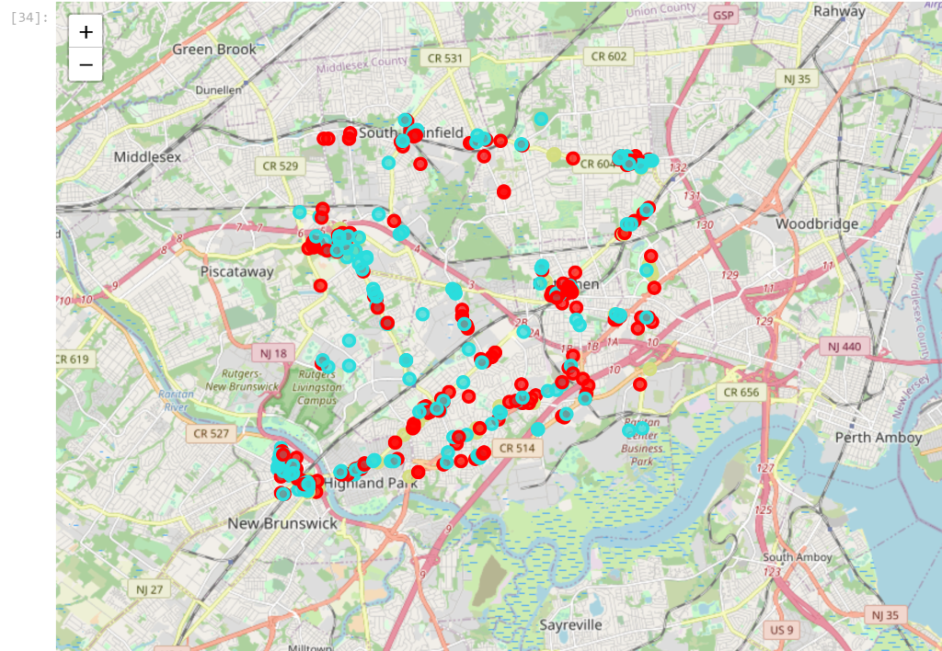
Clustering Analysis Using Kmeans (4 clusters)
Mapping of 4 clusters of restaurant businesses from Kmeans Clustering.
Cluster 3 found to be most significant based on mean values presented by Rating, Price and Review counts.

Slide 7
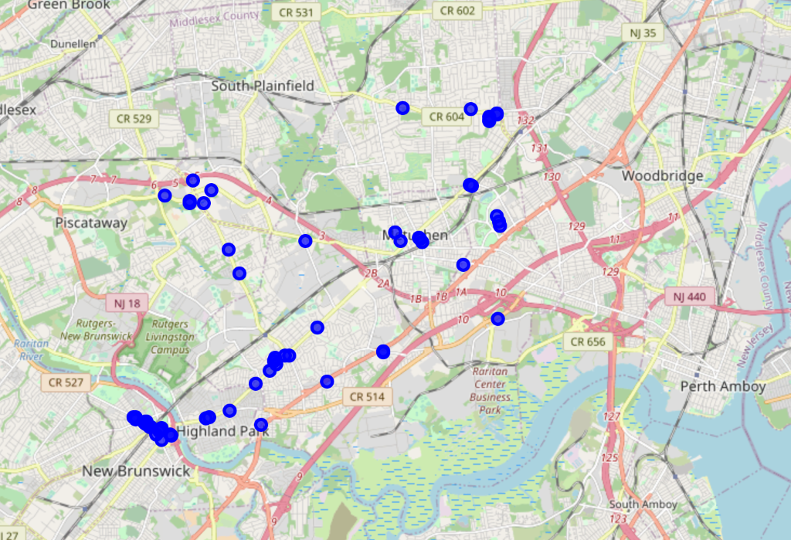
Results from Kmeans Clustering Analysis
Mapping of cluster 3 group of restaurants, showing a significant grouping around New Brunswick area.
Cluster 3 data shows American (4) and Indian (7) restaurants as top performers

Slide 8
Recommendations
Launch a Tex-Mex restaurant in Edison, NJ given its success and ratings in New Brunswick area, also currently there no Tex-Mex category of restaurants in Edison, NJ as of now.
Launch a Pakistani restaurant in New Brunswick, NJ given there are none in this area and heavy Asian population will lead to similar success rates as shown by data points in Edison, NJ area.

Slide 9
Conclusions
Based on restaurant business data points gathered around Edison, NJ using Yelp’s Business Search API, it provides sufficient information to cluster these restaurants into top performing group based on their Rating, price and reviews.
Cluster 3 represents the group of restaurants falling into most successful and best performing based on these data attributes. Further analyzing based on top performing cluster and looking at over all data points, as shown in above sections (5. Results and 6. Recommendations) I can confidently conclude that restaurants under Tex-Mex and Pakistani category will flourish very well in this area.

